Slide 1
Graph based SIEM log analysis
June 2021

Slide 2
Problem Illustration
High volume of alerts generated on daily basis:
Snort logs have an average of 4000 to 16000 alerts daily.
Windows logs have an average of 20,000 alerts daily.
Certain patterns of suspicious activities emerge over couple of days/ weeks:
23.235.252.66
108.163.130.184
IDS alerts
MITRE ATT&CK
Tactic: Command and Control
Technique: Application Layer Protocol
Malware Family : RuRat
SLR Alert – RuRat Checkin – Base64 Encoded XML
SLR Alert - Possible RuRat Checkin XML Elements
66.240.205.51
5748
115
10.1.1.50
Host X
1296
42 alerts in host log generated in span of 5 minutes : An account failed to log on – 0xC0000064 – user name does not exist
All alerts generated in short time frame, with different source port for each connection.
Large volume of IDS alerts generated suspecting trojan activity
10.1.1.50
Insight from Snort logs
Insight from Windows logs
Early September
30th September

Slide 3
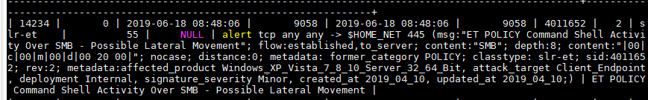
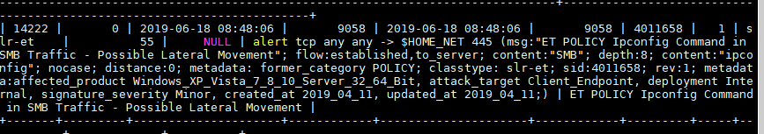
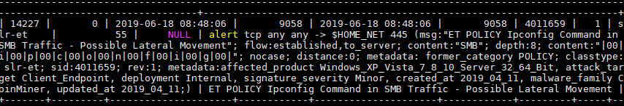
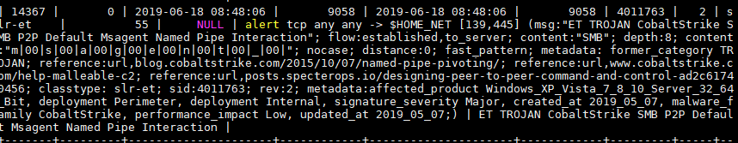
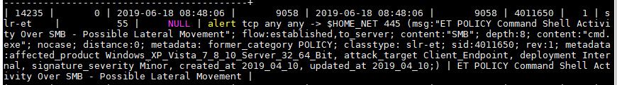
Problem Illustration
10.1.1.231
10.1.1.232
1:4011652, 1:4011658, 1:4011659,
1:4011763,
1:4011650
445
10.1.1.233
445
10.1.1.234
10.1.1.161
10.1.1.235
445
Fortigate-traffic-forward-close
445
135
445
172.16.0.119
Sep - Oct

Slide 4
Problem Definition
How to identify “suspicious” collection of events across logs ?
How to connect events within a log and across log types?
How to measure severity of collection of events?
How to represent the collection of events for easier visualization and understanding?

Slide 5
Graph based SIEM log analysis
Motivating Example 1:
23.235.252.66
108.163.130.184
IDS alerts
MITRE ATT&CK
Tactic: Command and Control
Technique: Application Layer Protocol
Malware Family : RuRat
SLR Alert – RuRat Checkin – Base64 Encoded XML
SLR Alert - Possible RuRat Checkin XML Elements
66.240.205.51
5748
115
10.1.1.50
Host X
1296
42 alerts in host log generated in span of 5 minutes : An account failed to log on – 0xC0000064 – user name does not exist
All alerts generated in short time frame, with different source port for each connection.
Large volume of IDS alerts generated suspecting trojan activity
10.1.1.50
Insight from Snort logs
Insight from Windows logs
Early September
30th September

Slide 6
Graph based SIEM log analysis
Motivating Example 1 - Output:
Graph level attributes :
Severity Score, Consequences
108.163.130.184
Intensity of events
Intensity of events
66.240.205.51
Duration of events
10.1.1.50
Duration of events
Host X
Signature of events
Signature of events
23.235.252.66
Port distribution
Port distribution
September 2019

Slide 7
SIEM Event prioritization
Use Case
Use Case :
Network devices and end point hosts generate large quantities of alerts independently.
A system which takes as input alerts from multiple devices and generates as output a graph highlighting “collection of events” within and across log types and assigns severity score to each graph, can help in event prioritization to analysts.
Motivating Example:
For a start, we can consider network logs and host logs as the data sources. The information available in each of the logs consists of :
Network logs :
timestamp when alert was generated, device name, source and destination IP and ports,
signature used for alert generation. Signature used for alert generation consists of multiple information such as type of malicious activity (eg. Trojan activity), malware family information (if available), MITRE ATT&CK mapping (if available), short explanation on possible type of malicious activity (for eg. ‘SLR Alert – Possible RuRat checking XML elements).
Host logs:
ComputerName (identified for the host), user id, group id, ip, port, type of event (eg. An account failed to log on – user name is correct but the password is wrong), object type (for ex. Logon type 3 – Network) etc.

Slide 8

Solution Framework
IDS logs
Generate Graph
Nodes : IP address / computer name
Edge attributes: Signature, Timestamp, Ports
Consolidate Graph
NLP technique to identify similar edges
Calculate time and port based metrics
Firewall logs
Host logs
Calculate Severity score for each subgraph
Identify Subgraphs
Collection of nodes with edges similar in terms of signature , time and port information
Calculate Impact / Consequences for each subgraph
Collection of graphs.
Each graph containing a severity score and Impact.

Slide 9

Sonic D4 – Workflow
IDS logs
Host / Firewall logs
Input : Graph generated from events from each log type. Each edge contains attributes such as event signature, time, port information. Typically, each node pair would have multiple edges.
N₁₁
Signature, time, port
N₂₁
Signature, time, port
Initial graph
N₁₂
N₁₃
N₂₂
N₁₃
Collate Edges
Collate Edges
Collate edges : Edges between each node pair, which are similar in signature information, are collated together. Time and Port metrics are calculated for each collated edge.
Collated graph
N₁₁
Signature, time, port metrics
N₂₁
Signature, time, port metrics
N₁₂
N₁₃
N₂₂
N₁₃
Subgraph Identification
Subgraph Identification
Subgraph identification : Identification of collection of nodes which are similar in terms of event signatures, event time and port metrics.
Score assigned to each subgraph.
N₁₁
N₂₁
N₂₁
Subgraph - IDS
Score
Score
Score
N₁₂
N₁₃
N₂₂
N₁₃
Linking of subgraphs across log types : Subgraphs from each log type are linked with each other based on common nodes.
Score assigned to each subgraph.
Consequences : List of possible consequences based on event signatures.
Link across log types
N₂₁
N₁₁
Score
Consequences
Score
Consequences
N₁₂
N₁₃
N₂₁
N₂₂

Slide 10
Solution Framework Main Components
Subgraph Generation
Severity Calculation
Impact / Consequences Identification

Slide 11
Component 1 - Subgraph Generation
Capture all outbound edges from node
Host / Firewall logs
Identify all edges within 1 month of each other
N₂₁
Signature, time, port
Time Metrics : Dispersion of inter-arrival time, Span
Port metrics : # of unique ports, Gini index
Signature Similarity : Based on Word2vec vector similarity for signature description
Loop for all nodes
N₂₂
N₁₃
Cluster all edges based on event signature similarity
Collate Edges
N₂₁
Signature, time, port metrics
Calculate following metrics for each clustered edge: time metrics, port distribution
N₂₂
N₁₃
Subgraph Identification
[DNS Query to a *.ngrok domain (ngrok.io),
DNS Query for .cc TLD,
DNS Query to a *.pw domain - Likely Hostile,
DNS Query to a *.top domain - Likely Hostile,
DNS Query for .to TLD]
Sets of similar words between signatures.
Use overall classification provided for the log type (if available)
Identify signature clusters which are “similar”
N₂₁
N₂₁
Score
Score
N₂₂
N₁₃
Convert signatures to one-hot encoding.
Cluster edges on basis of vectors formed using numerical and signature vectors.

Slide 12
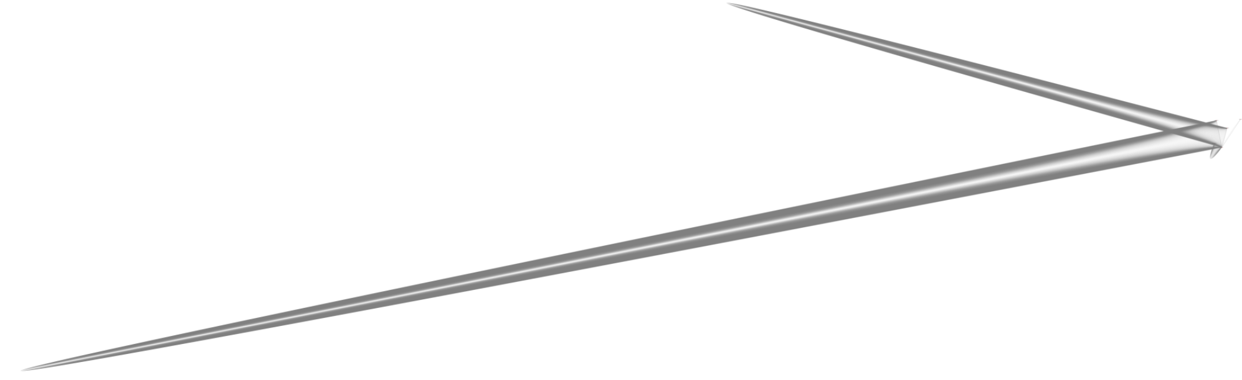
Graph Collation and Subgraph identification - Example
23.235.252.66
Graph representing all edges between 6 IP addresses - IDS
Number of events : 2867
IP addresses : 10.1.1.50’, ‘10.1.1.215’, 23.235.252.66’,’ 66.240.205.51’,’ 108.163.130.184’
Signature:
Timestamps: From 1st September to 30th September 2019.
Source ports – Randomly distributed > 1024
Target port - 5655
Timestamp : 2019-09-01 10:30:26
Signature :1:4102500, 1:4102501
S Port : 49365
T Port :: 5655
Signature | Count | Message
1:4102500 | 1432 | SLR Alert – RuRat Checkin – Base64 Encoded XML
1:4102501 | 1433 | SLR Alert – Possible RuRat Checkin XML Elements
66.240.205.51
10.1.1.50

Slide 13
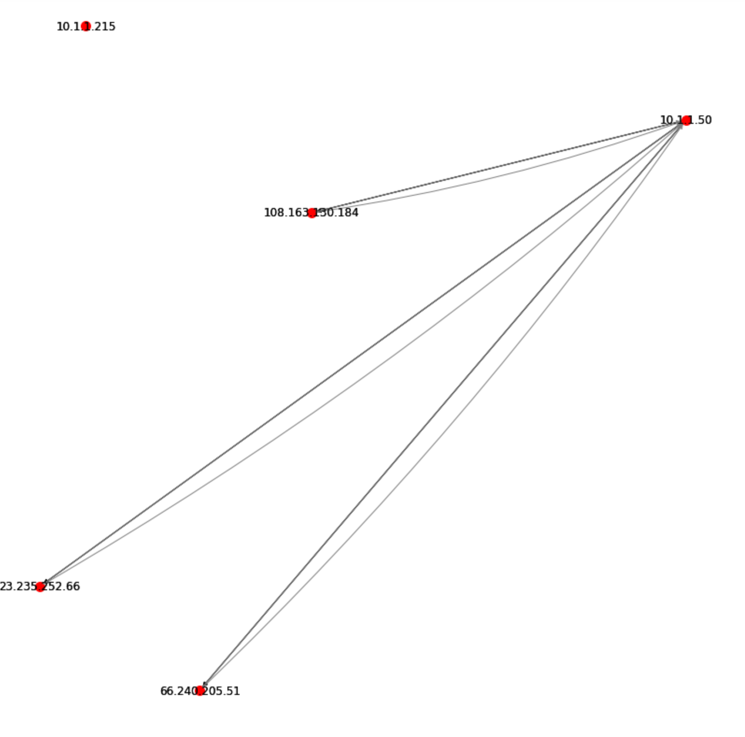
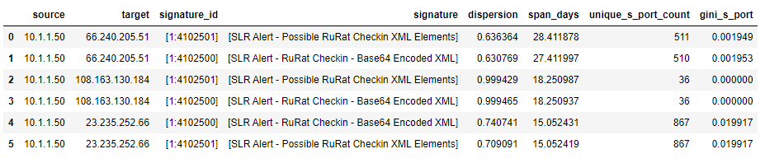
Graph Collation and Subgraph identification - Example
Collated Graph between 6 IP addresses – IDS
10.1.1.215
10.1.1.50
108.163.130.184
23.235.252.66
66.240.205.51
Dispersion : (Q3-Q1)/(Q3+Q1) if inter-arrival time between events
Span = Q3- min of timestamp values

Slide 14
Solution Framework Main Components
Subgraph Generation
Severity Calculation
Impact / Consequences Identification

Slide 15
Component 2 - Severity scoring
How to identify “severity” of events captured in each subgraph?
10.1.1.50
108.163.130.184
Each collated edge contains one or more signatures associated with the edge.
How to assign a severity score to these signatures?
Each collated edge contains numerical metrics calculated on basis of time and port information.
How do they impact Edge Score for each collated edge?
23.235.252.66
66.240.205.51
Collated Edges
Subgraph
Signature Severity Score
Metric Score
Edge Score

Slide 16
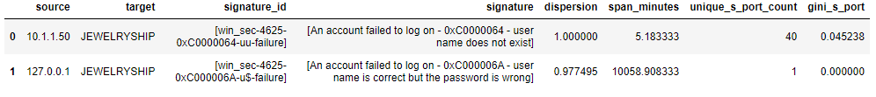
Component 2 - Severity scoring
Impact of numerical metrics on edge scoring
All communications to host with computername = ‘Host X’
Timestamps: From 2st September to 30th September 2019.
Source ports – Randomly distributed > 1024
Event | Count | Message
win_sec-4625-0xC0000064-uu-failure | 42 | An account failed to log on - 0xC0000064 - user name does not exist
Host X
All communications to host with computername = ‘Host Y’
Timestamps: From 1st October to 30th October 2019.
Event | Count | Message
win_sec-4625-0xC0000064-uu-failure | 1 | An account failed to log on - 0xC0000064 - user name does not exist
Host Y

Slide 17
Edge scoring
Collated edge
More
Signatures in collated edge?
Signature Severity score for collated edge = max {scores for all signatures}
For signature in edge
yes
no
Calculate score for signature
Metric score for collated edge
More
Signatures in collated edge?
From all collated graphs for each Log Type
Collated edge
yes
no
Metric exceeds threshold?
For metric in edge
Metric contributes to Metric Score
Calculate Threshold for Signature Severity, and Metrics
yes
no
Ignore

Slide 18
Edge scoring
Signature Severity Score Calculation
Types of numerical scores for each signature
Signature Score calculation for Collated edge
CVE Score
IDS
Collated Edges IDS
Max (All CVE Scores) + Max (All Signature Priority values)
Signature priority
CVE Score
Firewall
Collated Edges Firewall
CAPEC Score
0.7 * Max (All CVE Scores) + 0.3 * Max (All Signature CAPEC Scores)
All Scores in range (0,10)
NLP approach to map Firewall signatures to CAPEC
Windows
CAPEC Score
Collated Edges Windows
Capec Scores
Windows Event Id captured in ATT&CK descriptions. ATT&CK to CAPEC mapping for scoring.
NLP + Manual effort to map remaining to CAPEC

Slide 19
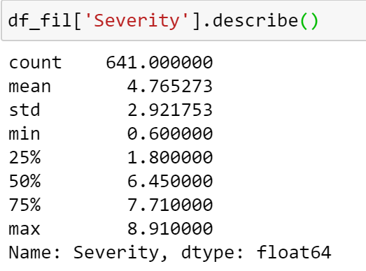
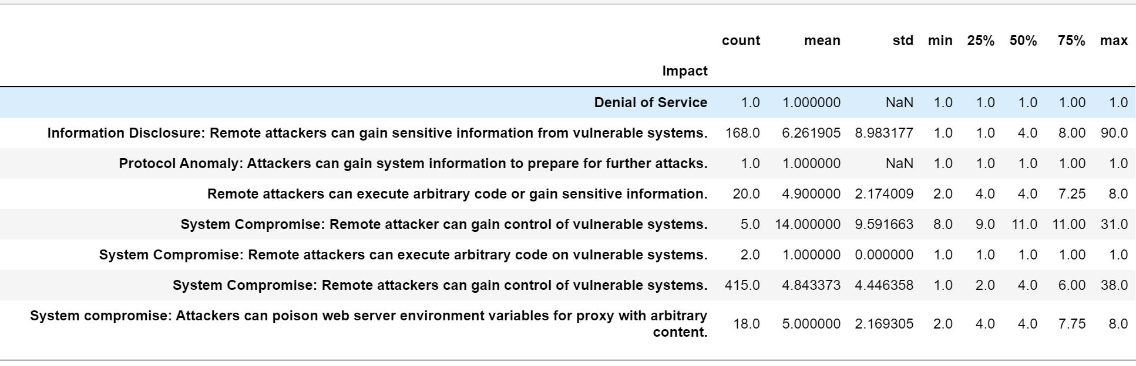
Metric scoring
Metric Threshold Calculation - Firewall
Collated graphs for each month for Firewall (Sep, Oct 2019, March, April, May, June July 2020)
Collated graphs for each month for Firewall (Sep, Oct 2019, March, April, May, June July 2020)
Signature Severity distribution for all non-audit signatures
Signature Severity distribution for all audit signatures
Filter all edges for non-audit signatures
Group all metrics on basis of “Impact” corresponding to signatures
Signature Severity Threshold = 50 percentile
Signature Severity Threshold = 75 percentile
Threshold for each metric : 50% of distribution for each impact.
Metrics : Port Count , Port Gini
Firewall (Types of signatures):
Audit : “fortigate-traffic-forward-deny”
Non-Audit : “fortigate-46176”

Slide 20
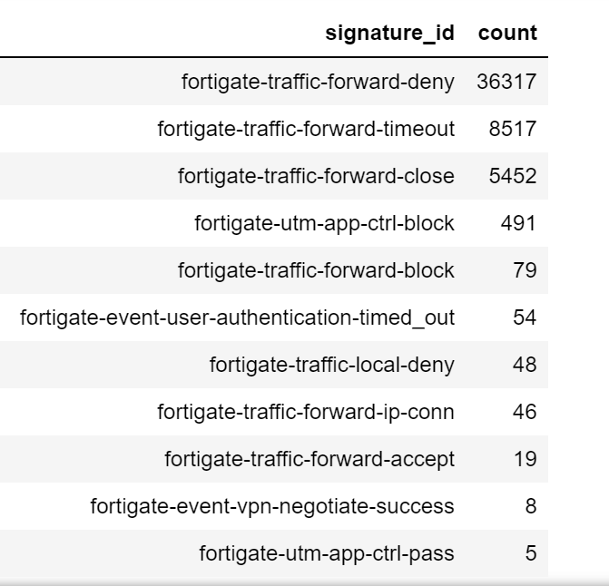
Metric scoring
Metric Score Calculation - Firewall
Each collated edge
Firewall (Types of signatures):
Audit : “fortigate-traffic-forward-deny”
Non-Audit : “fortigate-46176”
Metric Score = 1 (Dispersion) + 1 (Span) + 1 (Ports)
Signature Score > Signature Severity Threshold for non-audit signature
Contains non-audit signature
yes
yes
no
no
Metric Score = Dispersion + Span (scaled 0-1) + 1 (if any of port threshold exceeded)
Signature Score > Signature Severity Threshold for audit signature
no
Metric Score = 0
yes
Metric Score = Dispersion (if Dispersion > Threshold) +
Span (if Span > Threshold) + 1 (if any port threshold exceeded)

Slide 21
Subgraph Scoring
Each collated edge
Score for each collated edge = Signature score + Metric score
Score for subgraph = average of scores for each edge

Slide 22
Solution Framework Main Components
Subgraph Identification
Severity Calculation
Impact / Consequences Identification

Slide 23
Component 3 – Impact / Consequences
How to identify possible consequences of events captured in each subgraph?
IDS
Firewall
CAPEC
NLP approach to map Firewall signatures to CAPEC
Windows
Severity Based / Volume Based ?
Severity
Volume
Threshold for time metric met?
CAPEC Impact
For example,
Capec 94: Man in the Middle
Impact : Modify data, Gain Privileges, Read Data
No
Yes
CAPEC Impact
For example,
Capec 112: Brute Force
Impact : Read Data, Gain Privileges
Ignore

Slide 24
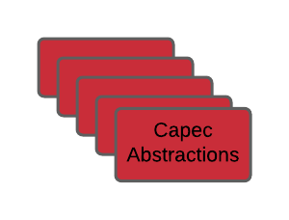
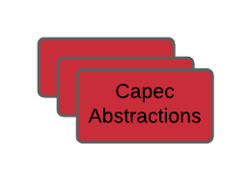
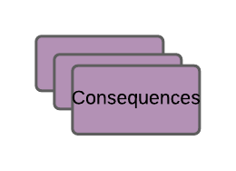
Component 3 – Impact / Consequences
How to identify possible consequences of events captured in each subgraph?
1
2
3
Signatures
Textual Mapping
Correction by numerical metrics
Extract corresponding consequences

Slide 25
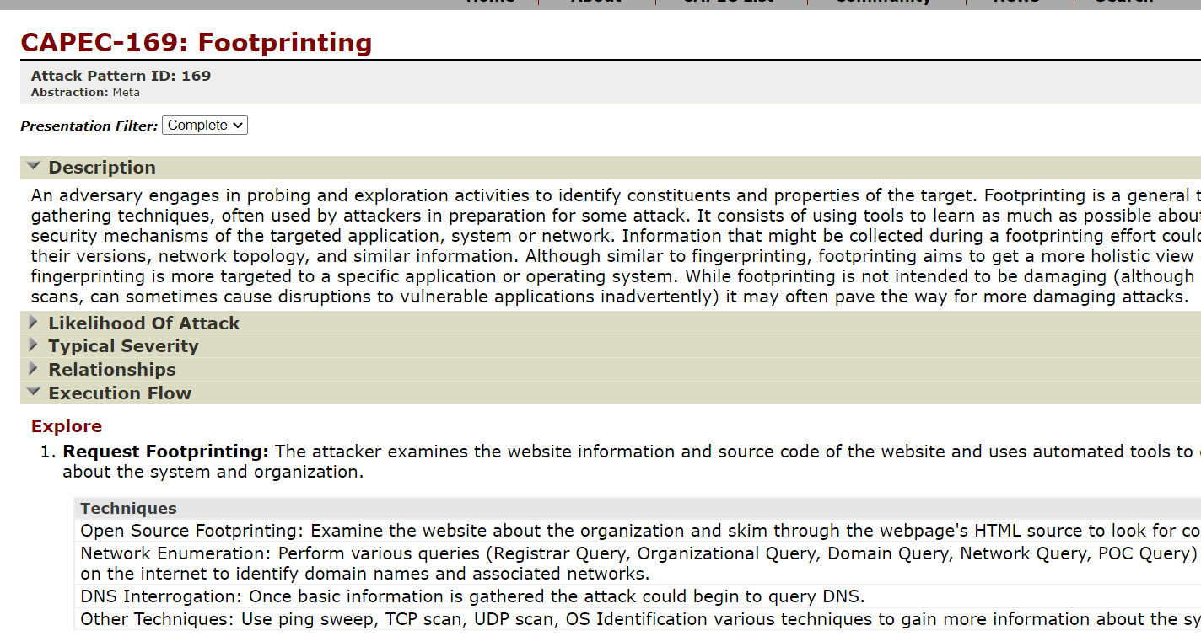
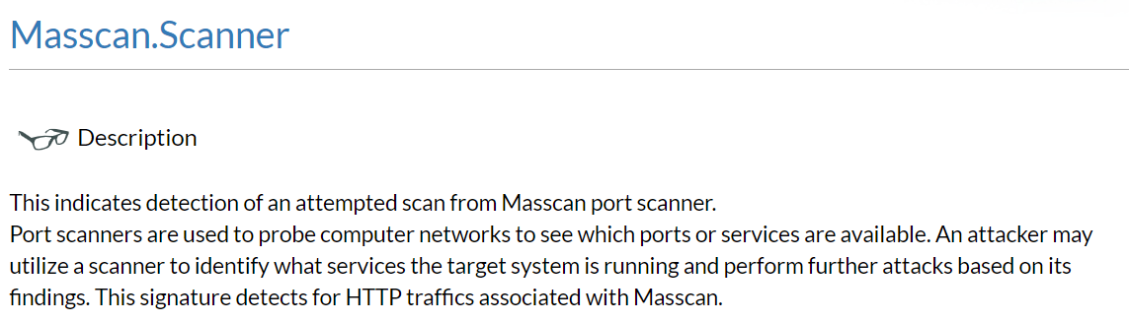
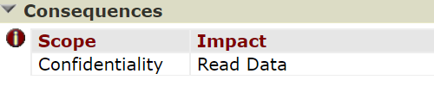
Component 3 – Impact / Consequences
Mapping Signatures to CAPEC
Capec
Firewall alert
Title
Title
+
Desc
+
Desc
+
+
Flow
Impact
+
Consequence
Notes:
Check the computer name associated
Include the time difference. E.g. a few minutes/secods, etc.
500: The server is responding to something, malicious as in the source port is always 500.
Port name for account log on seems to be random, big number.
Ipsec handshake failure
An IPsec Main Mode negotiation failed
Add the number of events exact

Slide 26
Component 3 – Impact / Consequences
Mapping Signatures to CAPEC
Sort and select top words
Tf-IDF
Calculate Similarity
Event Signature
Tf-IDF vectors for Event Words
Event Key Words
C1~C5
Capec Abstractions
Tf-IDF
Tf-IDF vectors for Capec words
Sort and select top words
Capec key words
Notes:
Check the computer name associated
Include the time difference. E.g. a few minutes/secods, etc.
500: The server is responding to something, malicious as in the source port is always 500.
Port name for account log on seems to be random, big number.
Ipsec handshake failure
An IPsec Main Mode negotiation failed
Add the number of events exact

Slide 27
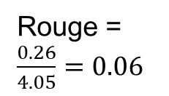
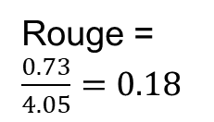
Component 3 – Impact / Consequences
Mapping Signatures to CAPEC
Rouge Score: word-level similarity between candidate (Capec) and reference (events) document.
Rouge formula: $\frac{Count(common keywords)}{Count(all event keywords )}$ $\frac{\sum_{w_{i}∈common grams}{{TF−IDF}_{w_{i}}}}{\sum_{w_{j}∈event keywords}{{TF−IDF}_{w_{j}}}}$
Differentiate important keywords
Similar descriptions
Firewall-42772 | proxy | redirection | header | … | web (0.18) | redirect (0.17) | traffic (0.17) | http | content | malicious (0.13) | multiple | improper | server (0.08)
Capec-161 | web | carriage | server | … | Bogus | fake | malicious | forge | response | contradictory | host | traffic | redirect
Rouge =
$\frac{0.73}{4.05}=0.18$
Irrelevant descriptions
Firewall-42772 | proxy | redirection | header | … | web (0.18) | redirect | traffic | http | content | malicious | multiple | improper | server (0.08)
Capec-248 | server | web | mail | … | tool | xml | string | unauthorized | field | availability | syntax | xpath | tamper
Rouge =
$\frac{0.26}{4.05}=0.06$

Slide 28
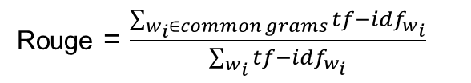

Component 3 – Impact / Consequences
Mapping Signatures to CAPEC
D | B | A(verb) | C
0.5 | 0.2 | 0.1 | 0.1
Firewall Signature
Identify Common words
Rouge = $\frac{\# of common grams}{Total \# of grams}$
G | D | A(noun) | C
0.6 | 0.3 | 0.2 | 0.05
Capec
Common words with higher tf-idf score (e.g. D) have more impact than the others (e.g. A, C)
Rouge = $\frac{\sum_{w_{i}∈common grams}{{tf−idf}_{w_{i}}}}{\sum_{w_{i}}{{tf−idf}_{w_{i}}}}$

Slide 29
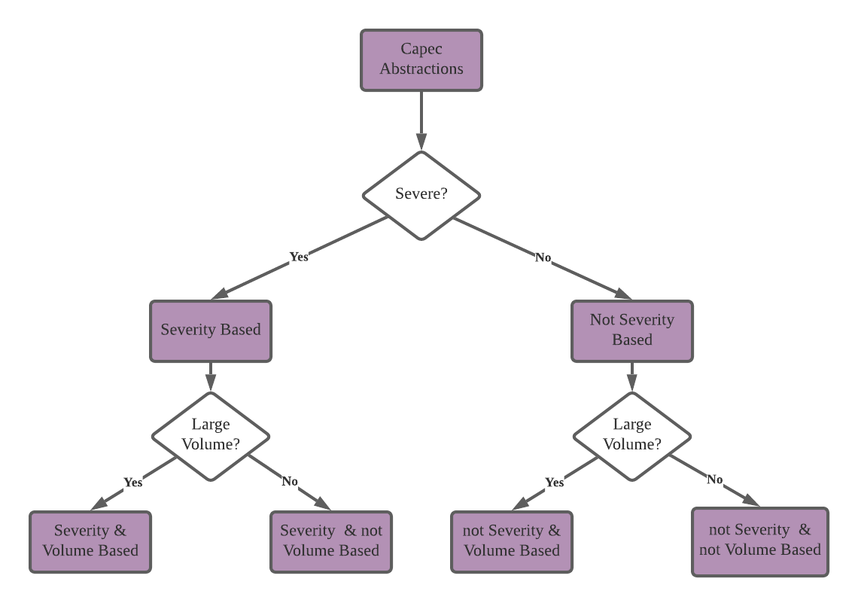
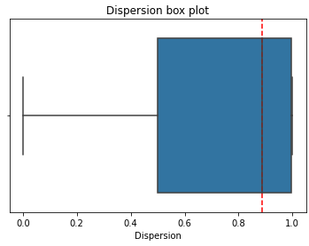
Component 3 – Impact / Consequences
Mapping Signatures to CAPEC
Categorise capec abstractions based on severity and volume based.
Set thresholds of dispersion, span, etc for each category.
Eliminate the mappings with numerical values lower than threshold.
Reject
Accept

